Slide 1
Introduction to XML Extensible Markup Language

Slide 2
Structured vs. unstructured data
Relational databases are highly structured
All data resides in tables
You must define schema before entering any data
Every row confirms to the table schema
Changing the schema is hard and may break many things
Texts are highly unstructured
Data is free-form
There is no pre-defined schema, and it’s hard to define one
Readers need to infer structures and meanings
What’s in between these two extremes?

Slide 3
Semi-structured data
Observation: most data have some structure, e.g.:
Book: chapters, sections, titles, paragraphs, references, index, etc.
Item for sale: name, picture, price (range), ratings, promotions, etc.
Web page: HTML
Ideas:
Ensure data is “well-formatted”
If needed, ensure data is also “well-structured”
But make it easy to define and extend this structure
Make data “self-describing”

Slide 4
Why is the emergence of XML an important development?
XML stands for eXtensible Markup Language
Markup
Sequence of characters within a text or word processing file to define
Print properties
Display properties
Document's logical structure
XML is a markup language much like HTML
XML is a tool for defining languages
XML languages are easy to read
XML is self describing
Parse tree embedded in document
Grammar for language referenced via DTD/Schema
XML was designed to store and transport data
XML was designed to be self-descriptive

Slide 5
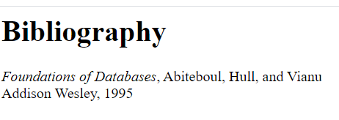
HTML: language of the Web
<h1>Bibliography</h1>
<p><i>Foundations of Databases</i>,
Abiteboul, Hull, and Vianu
<br>Addison Wesley, 1995
<p>
It’s mostly a “formatting” language
It mixes presentation and content

Slide 6
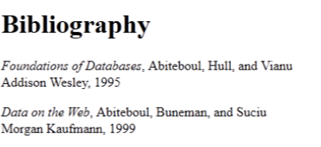
XML: eXtensible Markup Language
<bibliography>
<book>
<title>Foundations of Databases</title>
<author>Abiteboul</author>
<author>Hull</author>
<author>Vianu</author>
<publisher>Addison Wesley</publisher>
<year>1995</year>
</book>
<book>
…
</book>
</bibliography>
Text-based
Capture data (content), not presentation
Data self-describes its structure
Names and nesting of tags have meanings!

Slide 7
Other nice features of XML
Portability: Just like HTML, you can ship XML data across platforms
Relational data requires heavy-weight API’s
Flexibility: You can represent any information (structured, semi-structured, documents, …)
Relational data is best suited for structured data
Extensibility: Since data describes itself, you can change the schema easily
Relational schema is rigid and difficult to change

Slide 8
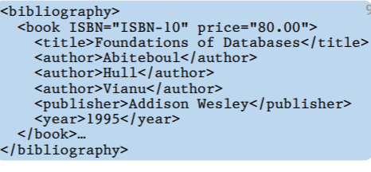
XML terminology
Tag names: book, title, …
Start tags: <book>, <title>, …
End tags: </book>, </title>, …
An element is enclosed by a pair of start and end tags:
<book>…</book>
Elements can be nested:
<book>…<title>…</title>…</book>
Empty elements: <is_textbook></is_textbook>
Can be abbreviated: <is_textbook/>
Elements can also have attributes
Must Always be Quoted
<book ISBN="…" price="80.00">
XML Tags are Case Sensitive

Slide 9
Well-formed XML documents
A well-formed XML document follows XML lexical conventions
Wrong: <section>We show that x < 0…</section>
Right: <section>We show that x &lt; 0…</section>
Other special entities:
> becomes &gt; and & becomes &amp;
Contains a single root element
Has properly matched tags and properly nested elements
Right: <section>…<subsection>…</subsection>…</section>
Wrong: <section>…<subsection>…</section>…</subsection>

Slide 10
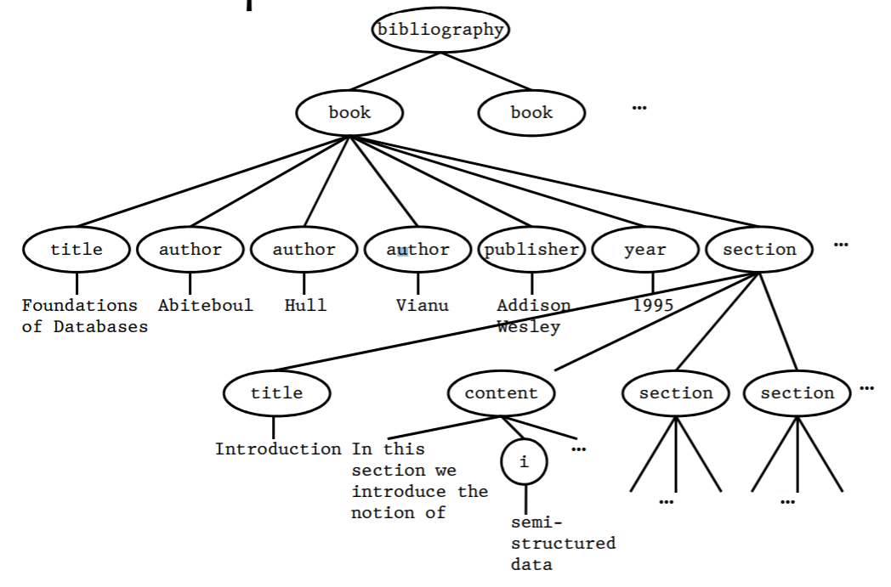
A tree representation

Slide 11
Parts of XML documents
XML Declaration
Elements
Attributes
XML Namespaces
Document Type Declaration
Entities
Comments
Character Data Sections

Slide 12
XML Declaration
<?xml version="1.0" encoding="UTF-8"?>
<note>
<to>Tove</to>
<from>Jani</from>
<heading>Reminder</heading>
<body>Don't forget me this weekend!</body>
</note>
The XML prolog is optional. If it exists, it must come first in the document.
Informs XML software of
the version of XML the document conforms to
the character encoding scheme used in the document
whether or not a set of external declarations affect the interpretation of this document

Slide 13
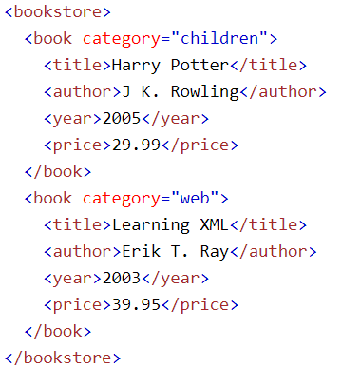
XML Elements
Define logical structure and sections of XML documents
An element can contain:
text
attributes
other elements
or a mix of the above
In the example
<title>, <author>, <year>, and <price> have text content because they contain text (like 29.99).
<bookstore> and <book> have element contents, because they contain elements.
<book> has an attribute (category="children").

Slide 14
XML Syntax Rules
XML Documents Must Have a Root Element
root element that is the parent of all other elements:
<root>
<child>
<subchild>.....</subchild>
</child>
</root>
In this example <note> is the root element
<?xml version="1.0" encoding="UTF-8"?>
<note>
<to>Tove</to>
<from>Jani</from>
<heading>Reminder</heading>
<body>Don't forget me this weekend!</body>
</note>

Slide 15
XML Naming Rules
XML elements must follow these naming rules:
Element names are case-sensitive
Element names must start with a letter or underscore
Element names cannot start with the letters xml (or XML, or Xml, etc)
Element names can contain letters, digits, hyphens, underscores, and periods
Element names cannot contain spaces
Best Naming Practices
Create descriptive names, like this: <person>, <firstname>, <lastname>.
Create short and simple names, like this: <book_title> not like this: <the_title_of_the_book>.
Avoid "-". If you name something "first-name", some software may think you want to subtract "name" from "first".
Avoid ".". If you name something "first.name", some software may think that "name" is a property of the object "first".
Avoid ":". Colons are reserved for namespaces (more later)

Slide 16
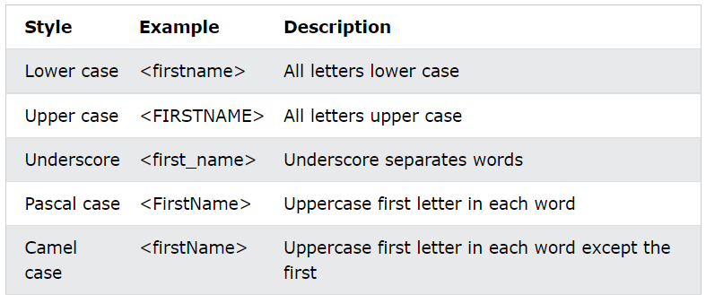
Naming Styles
There are no naming styles defined for XML elements. But here are some commonly used:

Slide 17
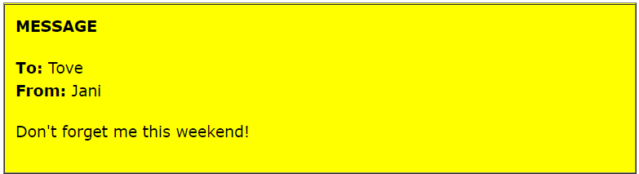
XML Elements are Extensible
XML elements can be extended to carry more information.
<note>
<to>Tove</to>
<from>Jani</from>
<body>Don't forget me this weekend!</body>
</note>
Let's imagine that we created an application that extracted the <to>, <from>, and <body> elements from the XML document to produce this output:

Slide 18
XML Elements are Extensible
Imagine that the author of the XML document added some extra information to it:
<note>
<date>2008-01-10</date>
<to>Tove</to>
<from>Jani</from>
<heading>Reminder</heading>
<body>Don't forget me this weekend!</body>
</note>
Should the application break or crash?
No. The application should still be able to find the <to>, <from>, and <body> elements in the XML document and produce the same output.
It can be extended without breaking applications.

Slide 19
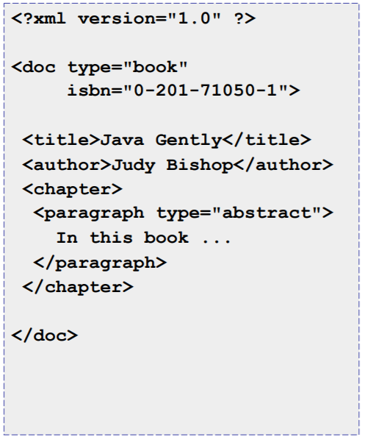
XML Attributes
Provides additional information about an element
Attributes are contained within the start-tag
Consists of a name and associated value separated by an equal's sign
The attribute value must always be enclosed by quotes
The order of attributes is insignificant

Slide 20
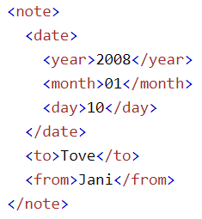
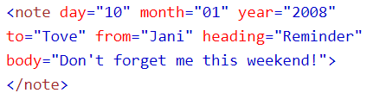
XML Elements vs. Attributes
Lexically little difference,
application specific,
no hard/fast rules available
Some things to consider when using attributes are:
attributes cannot contain multiple values (elements can)
attributes cannot contain tree structures (elements can)
attributes are not easily expandable (for future changes)

Slide 21
XML Attributes for Metadata
Sometimes ID references are assigned to elements.
These IDs can be used to identify XML elements in much the same way as the id attribute in HTML.
<messages> <note id="501"> <to>Tove</to> <from>Jani</from> <heading>Reminder</heading> <body>Don't forget me this weekend!</body> </note> <note id="502"> <to>Jani</to> <from>Tove</from> <heading>Re: Reminder</heading> <body>I will not</body> </note> </messages>

Slide 22
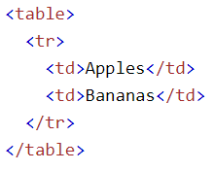
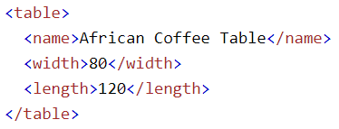
XML Namespaces
In XML, element names are defined by the developer.
This often results in a conflict when trying to mix XML documents from different XML applications.
If these XML fragments were added together, there would be a name conflict.
Both contain a <table> element, but the elements have different content and meaning.

Slide 23
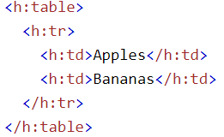
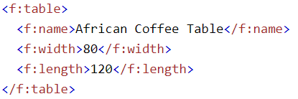
Solving the Name Conflict Using a Prefix
Name conflicts in XML can easily be avoided using a name prefix.

Slide 24
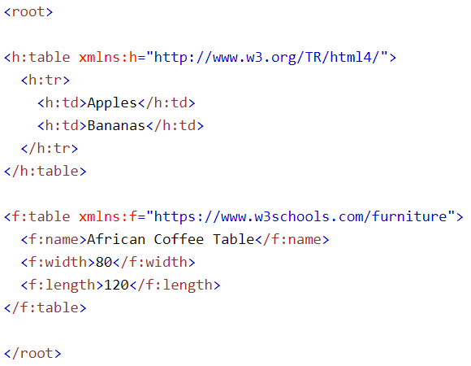
XML Namespaces - The xmlns Attribute
When using prefixes in XML, a namespace for the prefix must be defined.
The namespace can be defined by an xmlns attribute in the start tag of an element.
Syntax: xmlns:prefix="URI".
When a namespace is defined for an element, all child elements with the same prefix are associated with the same namespace.

Slide 25
XML Namespaces - The xmlns Attribute
The namespace URI is not used by the parser to look up information.
The purpose of using an URI is to give the namespace a unique name.
However, companies often use the namespace as a pointer to a web page containing namespace information.

Slide 26
Uniform Resource Identifier (URI)
A Uniform Resource Identifier (URI) is a string of characters which identifies an Internet Resource.
The most common URI is the Uniform Resource Locator (URL) which identifies an Internet domain address. Another, not so common type of URI is the Uniform Resource Name (URN).

Slide 27
Displaying XML
Raw XML files can be viewed in all major browsers.
<?xml version="1.0" encoding="UTF-8"?> <note> <to>Tove</to> <from>Jani</from> <heading>Reminder</heading> <body>Don't forget me this weekend!</body> </note>
Most browsers will display an XML document with color-coded elements.
Often a plus (+) or minus sign (-) to the left of the elements can be clicked to expand or collapse the element structure.
To view raw XML source, try to select "View Page Source" or "View Source" from the browser menu.

Slide 28
Why Does XML Display Like This?
XML documents do not carry information about how to display the data.
Since XML tags are "invented" by the author of the XML document, browsers do not know if a tag like <table> describes an HTML table or a dining table.
Without any information about how to display the data, the browsers can just display the XML document as it is.
If you want to style an XML document, use XSLT.

Slide 29
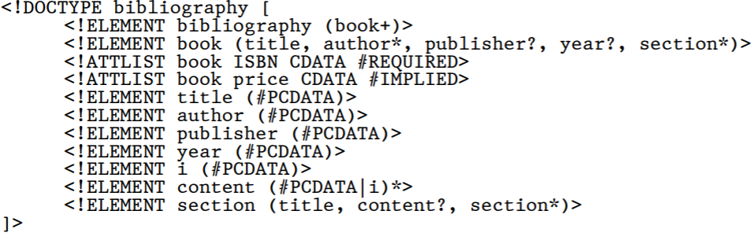
Valid XML documents
A DTD specifies a grammar for the document
Valid XML
Well-formed plus conforms to DTD
All elements and attributes are declared within a DTD (internal or external)
Elements and attributes match the declarations in the DTD
A DTD is optional
Example
Declare XML elements
Declaring Attributes

Slide 30
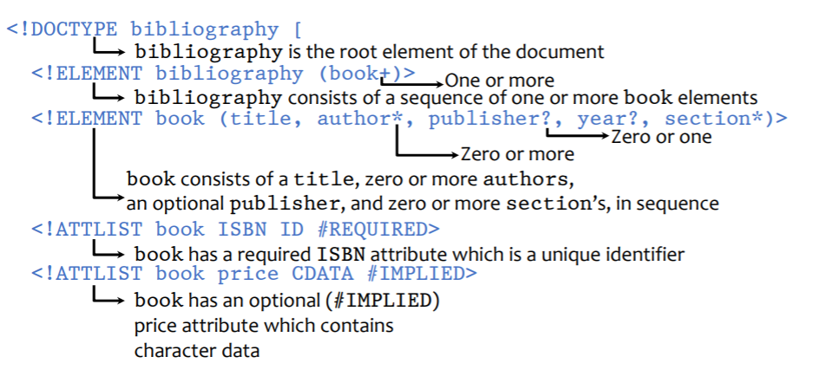
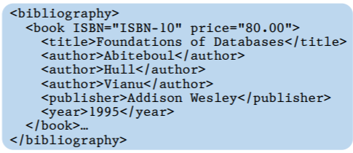
DTD explained

Slide 31
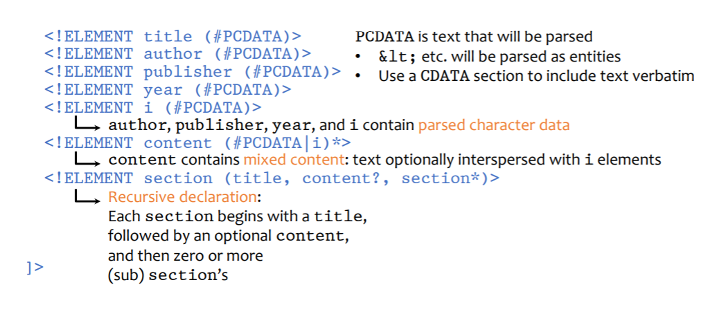
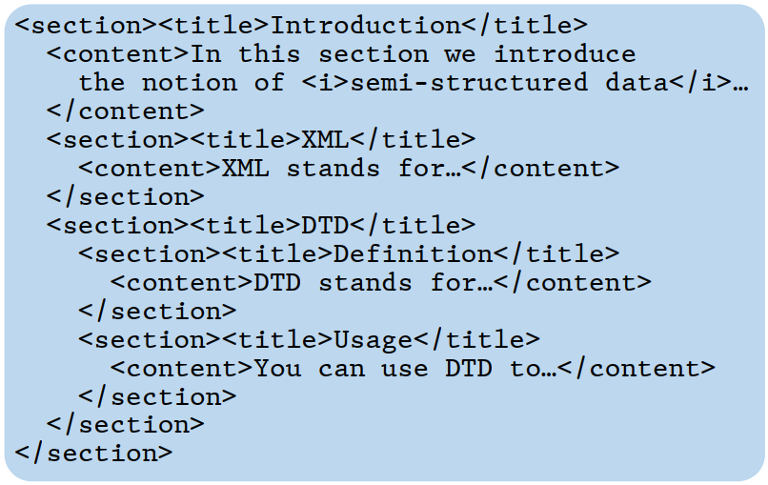
DTD explained

Slide 32
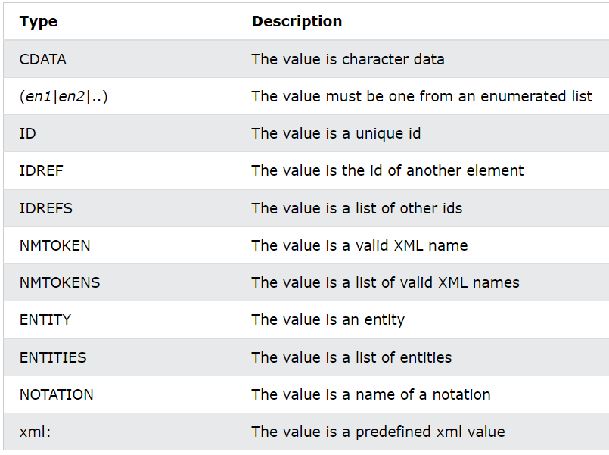
DTD – Attributes Type

Slide 33
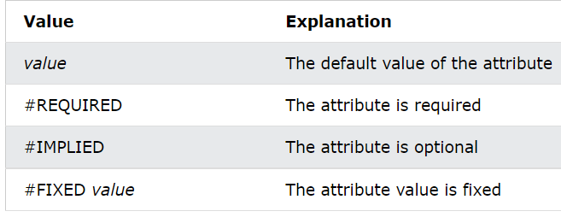
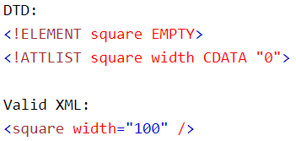
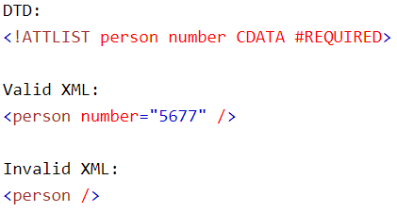
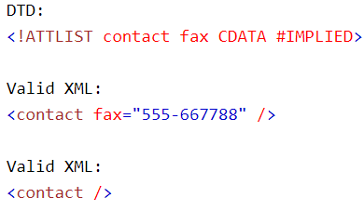
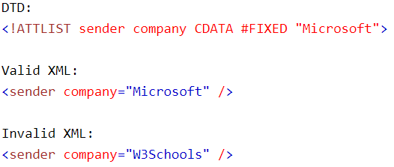
DTD – Attributes Value

Slide 34
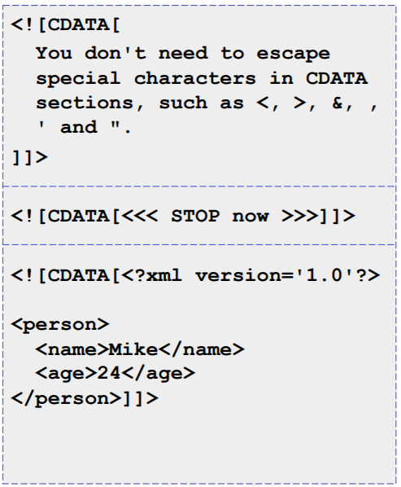
Character Data Sections
CDATA is text that will NOT be parsed by a parser.
An XML parser will not treat the contents of a CDATA section as markup
Used to simplify mark-up by escaping a selection of text
Entity references are not resolved
Useful for including source code in XML

Slide 35
Parsed Character Data
PCDATA is text that WILL be parsed by a parser, The text will be examined by the parser for entities and markup.
For example, if the parser encounters a < then it knows that the characters that follow represent an element instance. When the parser encounters a /, it knows that it has encountered an end tag.

Slide 36
IDs and IDREFs
An element can have at most one attribute of type ID
The ID attribute value of each element in an XML document must be distinct
Thus, the ID attribute value is an object identifier
An attribute of type IDREF must contain the ID value of an element in the same document
An attribute of type IDREFS contains a set of (0 or more) ID values. Each ID value must contain the ID value of an element in the same document

Slide 37
Using DTD
DTD can be included in the XML source file
<?xml version="1.0"?>
<!DOCTYPE bibliography [
… …
]>
<bibliography>
… …
</bibliography>
DTD can be external
<?xml version="1.0"?>
<!DOCTYPE bibliography SYSTEM "../dtds/bib.dtd">
<bibliography>

Slide 38
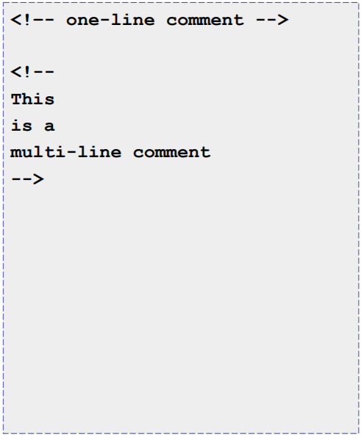
Comments
Used to comment XML documents
Not considered to be part of an XML document
An XML parser is not required to pass comments to higher level application

Slide 39
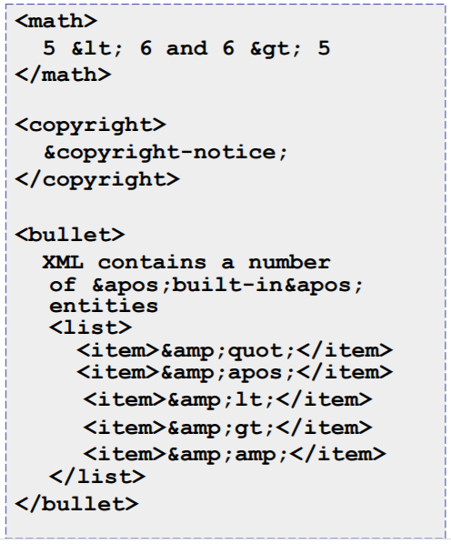
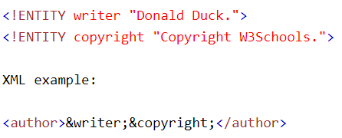
Entities
Character entities are used to insert characters that cannot be typed directly
XML contains a number of 'built-in' entities
&quot;
&apos;
&lt;
&gt;
&amp;

Slide 41
References
https://www.w3schools.com/html/
https://www.javatpoint.com/html-tutorial
https://www.tutorialspoint.com/html/index.htm
XML, DTD, and XML Schema, Introduction to Databases, CompSci 316 Fall 2014
Fundamentals of XML, Owen.Conlan@scss.tcd.ie

